Slide 2
Build Python apps in Azure faster with Visual Studio Code
Nicolas Garfinkel
Program Manager

Slide 3

Nicolas Garfinkel
Not Me
Me
PM on Microsoft’s Python Tooling Team
Father to a toddler (so productivity is crucial)
Self-Taught Python (Like many of you!)
Cooking, Hockey, Love Data
Also Not Me

Slide 4





Python on Azure
Python is a first-class language on Azure
Robust free-trial offering on many of the core services
Python SDK to tie it all together
Works great on Linux
Data Processing
Machine Learning
Azure Functions - Serverless
Cognitive Services - Convenient ML
CosmosDB - NoSQL
Web Applications
Azure Storage - File Storage
App Service – Hosting Web Applications

Slide 5

GitHub ‘Issue’ Visualization Tool
Python App on Azure
Download every issue filed on any public repo in GitHub
Apply ML to extract key phrases from each title
Store data in Azure Database
Visualize/Interact with that data through a WebApp
Data Processing
Machine Learning
Web Applications
GitHub
Data
CosmosDB
Table #1
CosmosDB
Table #2
App Services
(Web Hosting)
Azure Blob
Storage
API
GitHub
Data
Cognitive Services (ML)
GitHub
Data

Slide 6
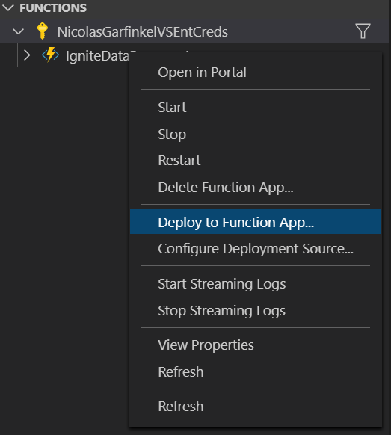
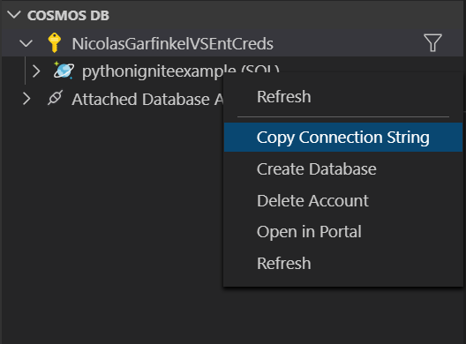
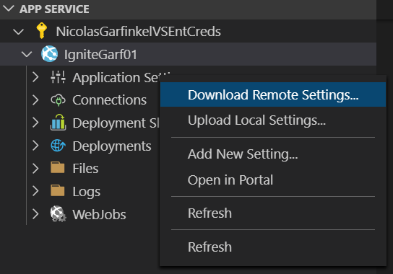
VS Code supercharges your Azure development
Focus on writing code ... less on configuring cloud services
Context switching has measurable impact on your development cycles
Efficiency can drop by as much as 40%
Impacts Long-term memory & creativity suffers
[1] Source: https://hbr.org/2010/12/you-cant-multi-task-so-stop-tr

Slide 7
Requirements (aka.ms/build2020pyvsc)
Python 3.7
Azure Subscription
Azure CLI
Visual Studio Code
VS Code Extensions
Azure Account
Azure App Service
Azure Functions
Azure Cosmos DB

Slide 8
Data Processing

Slide 9
Data Processing with Serverless - Azure Functions 101
What is Azure Functions?
Scalable event-driven serverless compute platform that also can solve complex orchestration problems
Common Uses:
Data Science - ML & Data Processing
System Admin - Cloud Automation
Web Developer - APIs, SPAs, Mobile backends
Free-Tier (Monthly)
*1 million requests
*400,000 GB-s of resource consumptions
*Free tier requires a consumption / pay-as-you-go plan.

Slide 10
Today’s App Architecture: Data Processing
Step #1: Download, Store into Blob
Call API & download hourly GZIP files
Store the files in Azure Blob Storage
Step #2: Unzip, Filter and Store in DB
Unzip, and transform the data into JSON
Filter on event type [New Issue Creation]
Reshape the data
Store in CosmosDB (Table #1)
Function #1
Function #2
Azure Storage
CosmosDB
Table #1
CosmosDB
Table #2
App Services
(Web Hosting)
GitHub
Data
API
GitHub
Data
Cognitive Services (ML)
GitHub
Data

Slide 11
Azure Functions Demo Create, and deploy with ease

Slide 12
Demo Takeaways
Azure Functions in VS Code speed up development cycles
Pre-made templates based on your selected trigger
Debugging locally to speed up your development cycles
Right-click deploy

Slide 13
Machine Learning

Slide 14
Today’s App Architecture: Intelligence
Step 3: Apply ML & Store in DB
Extract key phrases from every issue title using ML
Store in CosmosDB (Table #2)
Services
Azure Functions
Cognitive Services
CosmosDB
Function #3
Azure Storage
CosmosDB
Table #1
CosmosDB
Table #2
App Services
(Web Hosting)
GitHub
Data
API
GitHub
Data
Cognitive Services (ML)
GitHub
Data

Slide 15







Machine Learning: Cognitive Services 101
Cognitive Services
Help developers build intelligent applications without having direct AI or data science skills or knowledge
Machine Learning Magic
Vision | Computer Vision (Image Classification, OCR) Face (Face Detection, Emotion Recognition)
Speech | Speech Service (Speech-to-text) Speaker Recognition (Speaker identification)
Language | Text Analytics (Key Phrase Extraction, Sentiment) QnA Maker (QnA extraction from unstructured text)
Decision | Anomaly Detector (Business Health, IoT monitoring) Content Moderator (Profanity, offensive image detection)
Search | Bing Visual Search (Identify similar images and products) Bing Customer Search (Customer search engine creation)
“The weather is nice in Seattle”
Application
API Endpoint
[‘weather’, ‘Seattle’]

Slide 16
Data Processing with NoSQL - CosmosDB 101
Cosmos DB:
Globally distributed, multi-model NoSQL database service
Common Uses:
IOT device telemetry & supply chain
Real-time personalization & analytics

Slide 17
Machine Learning Demo Intelligence at scale
Trigger Function when records inserted into CosmosDB
Pass Issue Title to Cognitive Services API, return Key Phrases
3. Store results into CosmosDB for WebApp to read from

Slide 18
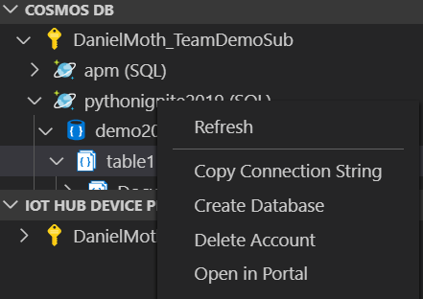

Demo Takeaways
Triggers and Output Bindings make it a great “orchestrator” between Azure services
Other Bindings: Event Hubs, Cosmos DB, 18+ other Azure services
Create, and Interact with Azure DBs directly from coding environment
CosmosDB (released), PostgreSQL (releasing May 2020), MySQL (Coming Soon!)
Cognitive services can add ML Intelligence as simple as calling an API

Slide 19
Web Applications

Slide 20
Today’s App Architecture: Web Application
Step 4: Build WebApp to read DB & visualize data
Build a WebApp that can read from the DB using the Python SDK
Visualize the data for any public Repo taking a Repo Name or ID
Services
CosmosDB
Azure App Service
"id": "1104",
"issue_id": 58698,
"issue_title": "Build fails with current mpv",
"issue_num": 184,
"repo_id": 0001,
"repo_name": “example",
"created_datetime": "2020-03-19T12:00:02Z",
"lastupdated_datetime": "2020-03-19T12:00:02Z",
"issue_url": "https://github.com/<>/<>/issues/184",
"last_state": "opened",
"NER": [
"Build",
"current mpv"
Step #4
Azure Storage
CosmosDB
Table #1
CosmosDB
Table #2
App Services
(Web Hosting)
GitHub
Data
API
GitHub
Data
Cognitive Services (ML)
GitHub
Data

Slide 21
Today’s App Architecture: Web Application
"id": "1104",
"issue_id": 58698,
"issue_title": "Build fails with current mpv",
"issue_num": 184,
"repo_id": 0001,
"repo_name": “example",
"created_datetime": "2020-03-19T12:00:02Z",
"lastupdated_datetime": "2020-03-19T12:00:02Z",
"issue_url": "https://github.com/<>/<>/issues/184",
"last_state": "opened",
"NER": [
"Build",
"current mpv"
Opportunities
Aggregating Issue Types by Key Phrase
Create a list of the most recent issues
Pull all issues related to “mpv”
Explore Individual Issues, with links back to individual issues
Calculate metrics on top of repos
Issues by Day
Time to close

Slide 22
Web Application: App Services 101
What is App Service?
build and host web apps, mobile back ends, and RESTful APIs
Key Features
Can host an application for free and scale up from there!
Deploy from CLI, VS Code, Portal (via GitHub and other paths)
Staging Slots so you don’t need to deploy straight to production
Supports both Linux and Windows

Slide 23
Web Application Demo Step 4 – Build WebApp to read/visualize data
Build a WebApp that can read from the DB using the new Python SDK
Visualize the data for any public Repo taking a Repo Name or ID

Slide 24
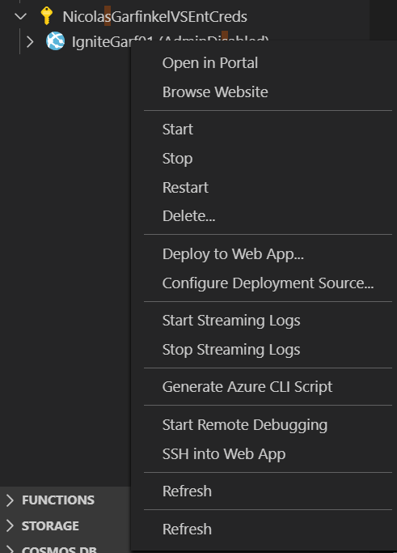
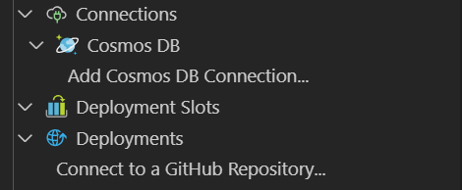
Demo Takeaways
VS Code’s App Service Extension let’s you create, deploy, and configure your web app without leaving your coding environment!
Azure App Service let’s us host WebApps without any of the overheard or maintenance
[Bonus] If you prefer the CLI, create/deploy in a single command: “az webapp up –n MyPythonApp”

Slide 25
Summary
Azure is a powerful cloud for Python applications, supports Linux
With VS Code, your development cycles are even faster thanks to key integrations with Azure
The Azure Python SDK is awesome! and consistent!! and idiomatic!!!
aka.ms/build2020pyvsc
GitHub Repo
Slides
Azure Free Trial
Discord channel for follow-up questions (limited time)
Learn More about Azure Services
Survey: Your Azure Python Experience
Requirements

